Slide 1
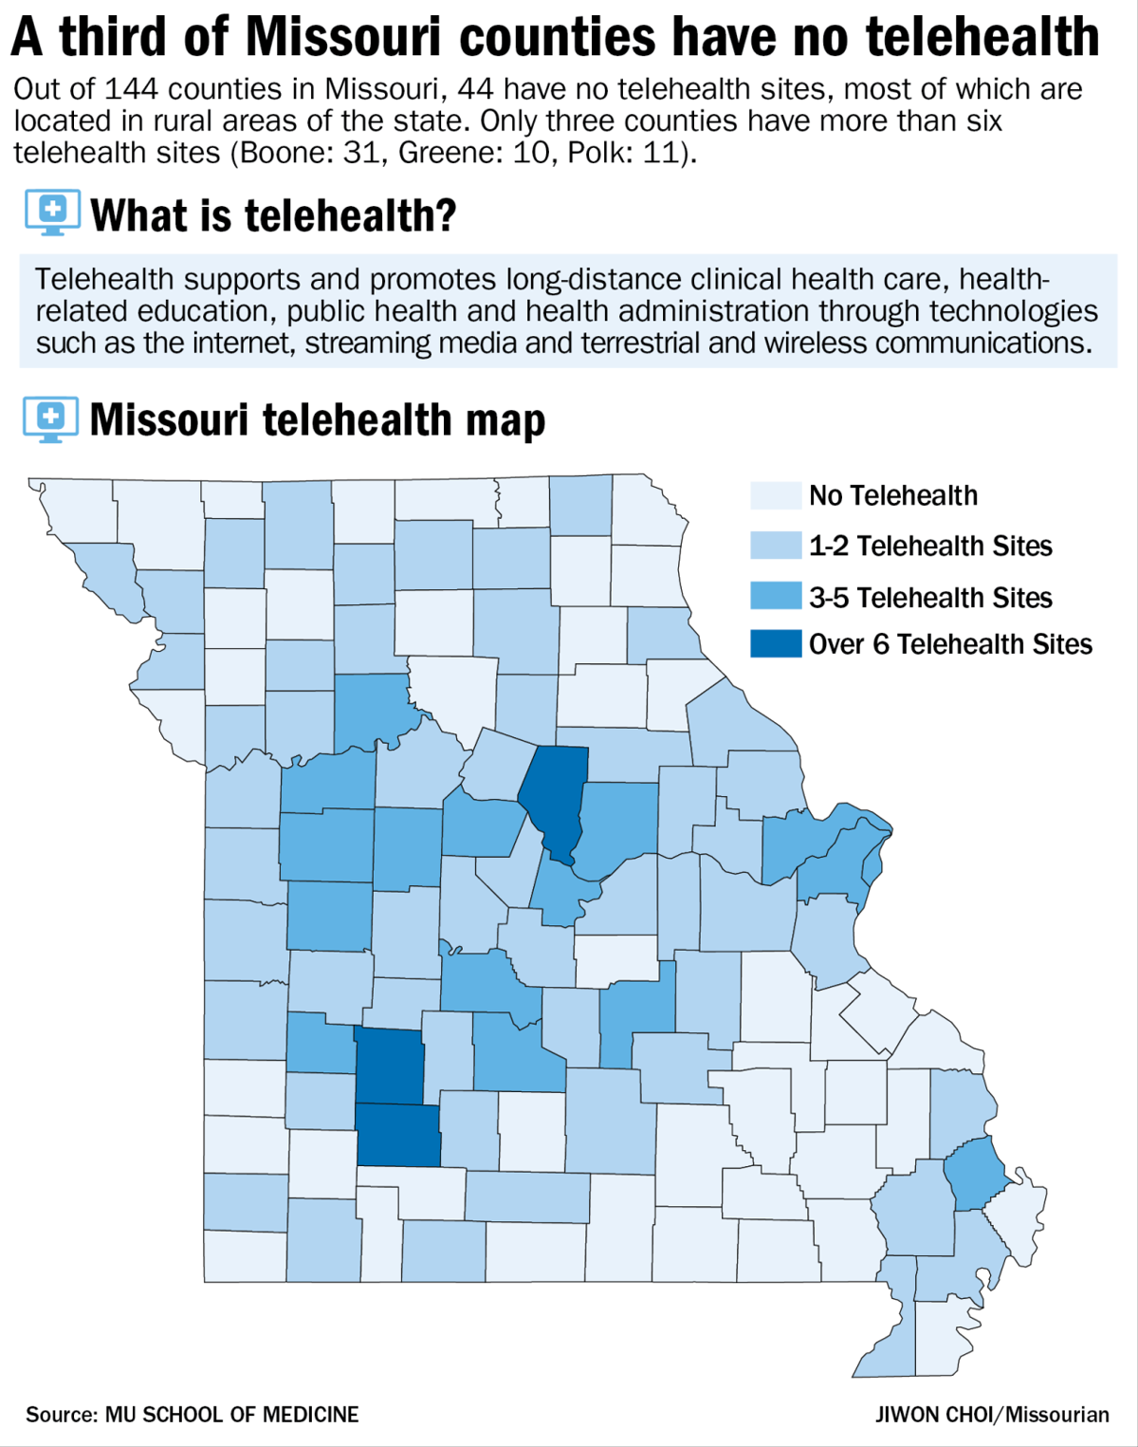
Introduction
Digital divide between the rural and urban areas of Missouri.
Telehealth improves the current need for ease of access to healthcare for rural communities.
Strengths, Weaknesses, Opportunities, Threats (SWOT) analysis will show viability of introducing telehealth to the rural communities of Missouri.
Notes:
Missouri encompasses a diversified geographical region with a digital divide between Urban and Rural region. Most of the best hospitals equipped with the newest technology, infrastructure, and workforce in terms of adoption of the latest technology for the top quality of healthcare services.
In contrast to the higher-rated hospitals in densely populated areas, rural hospitals lack basic infrastructure which is below the recommended norms in terms of accessibility of doctor-to-patients ratio in respect to the population.
Most of the doctors, nurses, administrators and other paramedical workers operating in rural hospitals are not exposed to technology as a result of lack of funds, policy, and infrastructure. Healthcare technology adoption will provide an effort towards shifting the lack of telehealth infrastructure currently provided to the rural communities of Missouri, from lacking to ease of access.
On the following slides: A SWOT analysis will be performed to identify the internal and external features of the organization that is going to influence establishing telehealth for the residents of Missouri. The SWOT analysis will help to improve the performances by maintaining the strengths and taking advantage of the opportunities. According to Phadermrod et al., (2019), this analysis will also help to reduce risks by coming up with strategies to deal with the threats and correct the weaknesses.

Slide 2
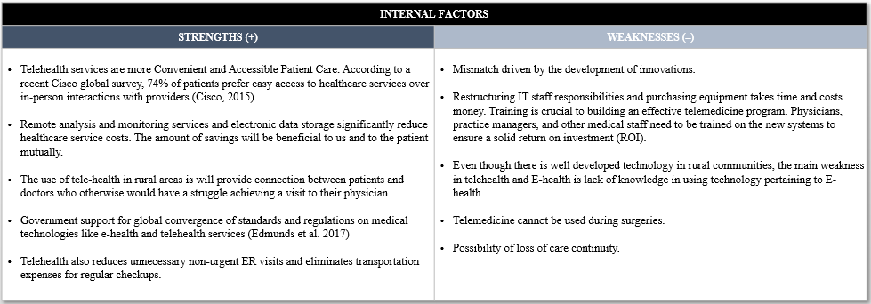
SWOT Analysis – Internal Factors
Notes:
(Because of the depth provided in the slide, the strengths will be read and reiterated, while allowing appropriate time for questions to be asked.)
Strengths:
Telehealth services are more Convenient and Accessible Patient Care. According to a recent Cisco global survey, 74% of patients prefer easy access to healthcare services over in-person interactions with providers (Cisco, 2015).
Remote analysis and monitoring services and electronic data storage significantly reduce healthcare service costs. The amount of savings will be beneficial to us and to the patient mutually.
The use of tele-health in rural areas is will provide connection between patients and doctors who otherwise would have a struggle achieving a visit to their physician.
Government support for global convergence of standards and regulations on medical technologies like e-health and telehealth services (Edmunds et al. 2017)
Telehealth also reduces unnecessary non-urgent ER visits and eliminates transportation expenses for regular checkups.
Weaknesses:
there is a mismatch driven by the development of telehealth and other technological innovations that do not take into account the actual needs of the patients. This mismatch reflects the different perspective from different parties involved in the process of telemedicine adoption highlighting problems of communication, collaboration, and lack of understanding between them. For instance, nurses and doctors may have a different understanding of a patient’s need.
Restructuring IT staff responsibilities and purchasing equipment takes time and costs money. Training is crucial to building an effective telemedicine program. Physicians, practice managers, and other medical staff need to be trained on the new systems to ensure a solid return on investment (ROI).
Even though there is well developed technology in rural communities, the main weakness in telehealth and E-health is lack of knowledge in using technology pertaining to E-health.
Telemedicine cannot be used during surgeries.
In instances that patients may use on-demand telemedicine services, connection with a random health care service providers leads to the concern of care continuity for that patient. The primary concern is that the patients' primary care provider may not have the appropriate access to the medical records or notes for that patient, thus having incomplete or lacking medical history for the patient.

Slide 3
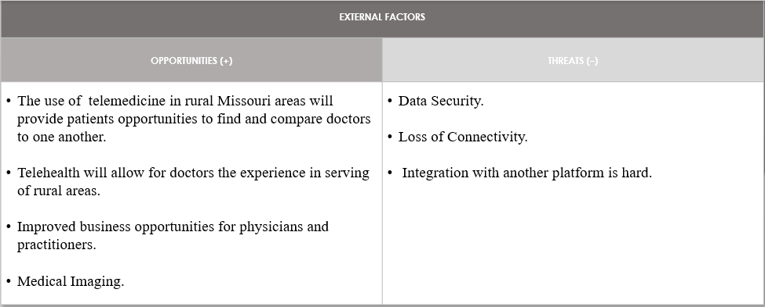
SWOT Analysis – External Factors
Notes:
Opportunities:
Aging and wealthier populations can offer an additional market in the state for these services as they are not able to travel to hospitals and clinics because of disabilities that are associated with aging populations, telehealth provides the necessary support to this population in addition to strict rural communities.
According to analyst, Christopher Cheney, a 2015 survey found that older physicians were nearly as likely as younger physicians to express interest in telemedicine jobs. Another note from the survey conveys that telemedicine allows residents and doctors the ability to serve in rural areas or those areas which suffer from health disparities.
The same survey also found that the number of physicians reporting telehealth as a skill doubled. Because of this growth it is apparent that physicians are currently utilizing telehealth as a platform to grow and expand their practices. Furthermore, there has been steady utilization of telehealth growth every year. There is no reason to think that this trend will not continue to increase (Cheney, 2019).
The use of telemedicine or teleradiology more specifically, would allow the opportunity for diagnostic images taken at off-site or small rural clinics to have official, legal and ethical readings from registered radiologists.
Threats:
Patient data confidentiality and security issues may prove a risk when cloud technology is implemented for at-risk when cloud technology is utilized to store and transfer patient data. There are several safeguards inherently and proactively implemented in most cloud technology structures, though these safeguards cannot guarantee 100% safety for patient data security.
A report was done in 2016 by the FCC titled the "Broadband Progress Report" this report discovered that broadband speeds were not being spread to all Americans in a timely fashion. The report found that over 10 percent of Americans (about 34 million) lacked access to speeds of at least 25 Mbps download and 3 Mbps upload (O’Dowd, 2018). These speeds are well below the standard needed for many rural patients to participate in telehealth programs. Health systems that serve largely rural areas that would benefit from telehealth programs can be prevented from participating because of the lack of broadband in certain areas.
Telehealth may prove troublesome in the integration of vital signs monitoring as well as with palliative care, such as, behavioral analysis based on such things as home care sensors (Lamprinakos et al, 2015).

Slide 4
References
Cheney, C. (2019). Healthleadersmedia.com. Retrieved 11 August 2019, from https://www.healthleadersmedia.com/clinical-care/more-physicians-pursuing-job-opportunities-telemedicine
Cisco (2015). Newsroom.cisco.com. Retrieved 8 August 2019, from https://newsroom.cisco.com/press-release-content?type=webcontent&articleId=1148539
Clark, M., & Goodwin, N. (2010). Sustaining innovation in telehealth and telecare. WSD Action Network, King's Fund.
Edmunds, M., Tuckson, R., Lewis, J., Atchinson, B., Rheuban, K., Fanberg, H., & Thomas, L. (2017). An emergent research and policy framework for telehealth. eGEMs, 5(2).
Lamprinakos, G. C., Asanin, S., Broden, T., Prestileo, A., Fursse, J., Papadopoulos, K. A., & Venieris, I. S. (2015). An integrated remote monitoring platform towards telehealth and telecare services interoperability. Information Sciences, 308, 23-37.
O’Dowd, E. (2018). HITInfrastructure. Retrieved 11 August 2019, from https://hitinfrastructure.com/news/lack-of-broadband-access-can-hinder-rural-telehealth-programs
Phadermrod, B., Crowder, R. M., & Wills, G. B. (2019). Importance-performance analysis based SWOT analysis. International Journal of Information Management, 44, 194-203.

